Slide 1
Chapter 6 Work and Machines
Section 1 – Work

Slide 2
What is Work?
Let’s Review and Connect…
Define energy: ________________________________________________
_______________________________________________________________________
What is a force? _______________________________________________
What unit is used to represent Force? _________ Distance? ____________
What does it mean to describe something as powerful? _______________________
__________________________________________________________________________

Slide 3
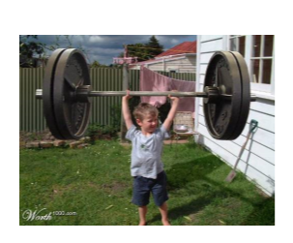
What is Work?
In which picture is the person actually doing work?
Why?

Slide 4
What is Work?
Work: The transfer of energy that occurs when a force makes an object move. Work is measured in Joules.
Two things must happen for a force to do work on an object.
The force must push or pull on the object.
The object must move a distance in the direction of the force applied.
Both must happen; otherwise, no work is done!

Slide 5
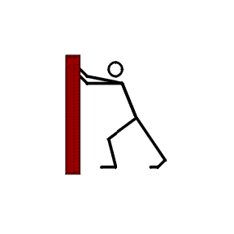
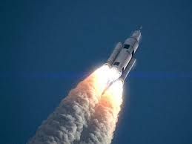
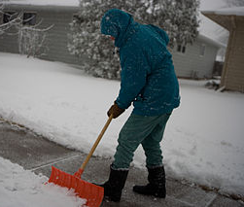
What is Work?
Work or NOT Work?
Circle the examples that ARE examples of work being done.

Slide 6
Calculating Work

Slide 7
Calculating Work
When moving a huge present across the room, you exert a force of 400 Newtons and are able to push it 4 meters. How much work have you done on this ginormous present?

Slide 8
What is Power?
Power: The amount of work done in a certain amount of time. Power is measured in Watts.
Power reflects two variables: Work and Time

Slide 9
Calculating Power

Slide 10
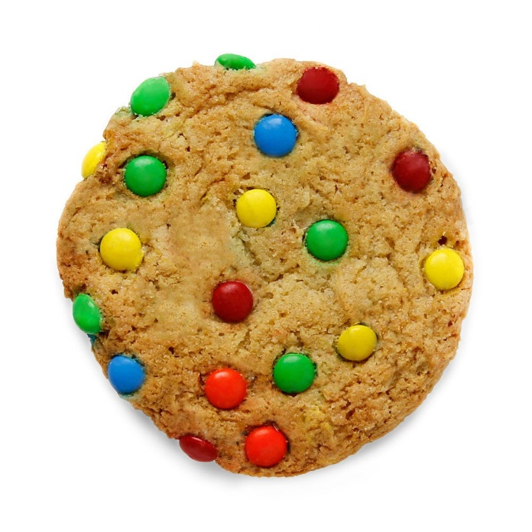
Calculating Power
To lift a cookie from the plate to your mouth, 3 joules of work is done. How much power is needed if the cookie is lifted in 0.5 seconds?

Slide 11
Work and Power
Explain a situation where a force is applied but no work is done?
How are work and energy related?
How is power related to work?

